Slide 1
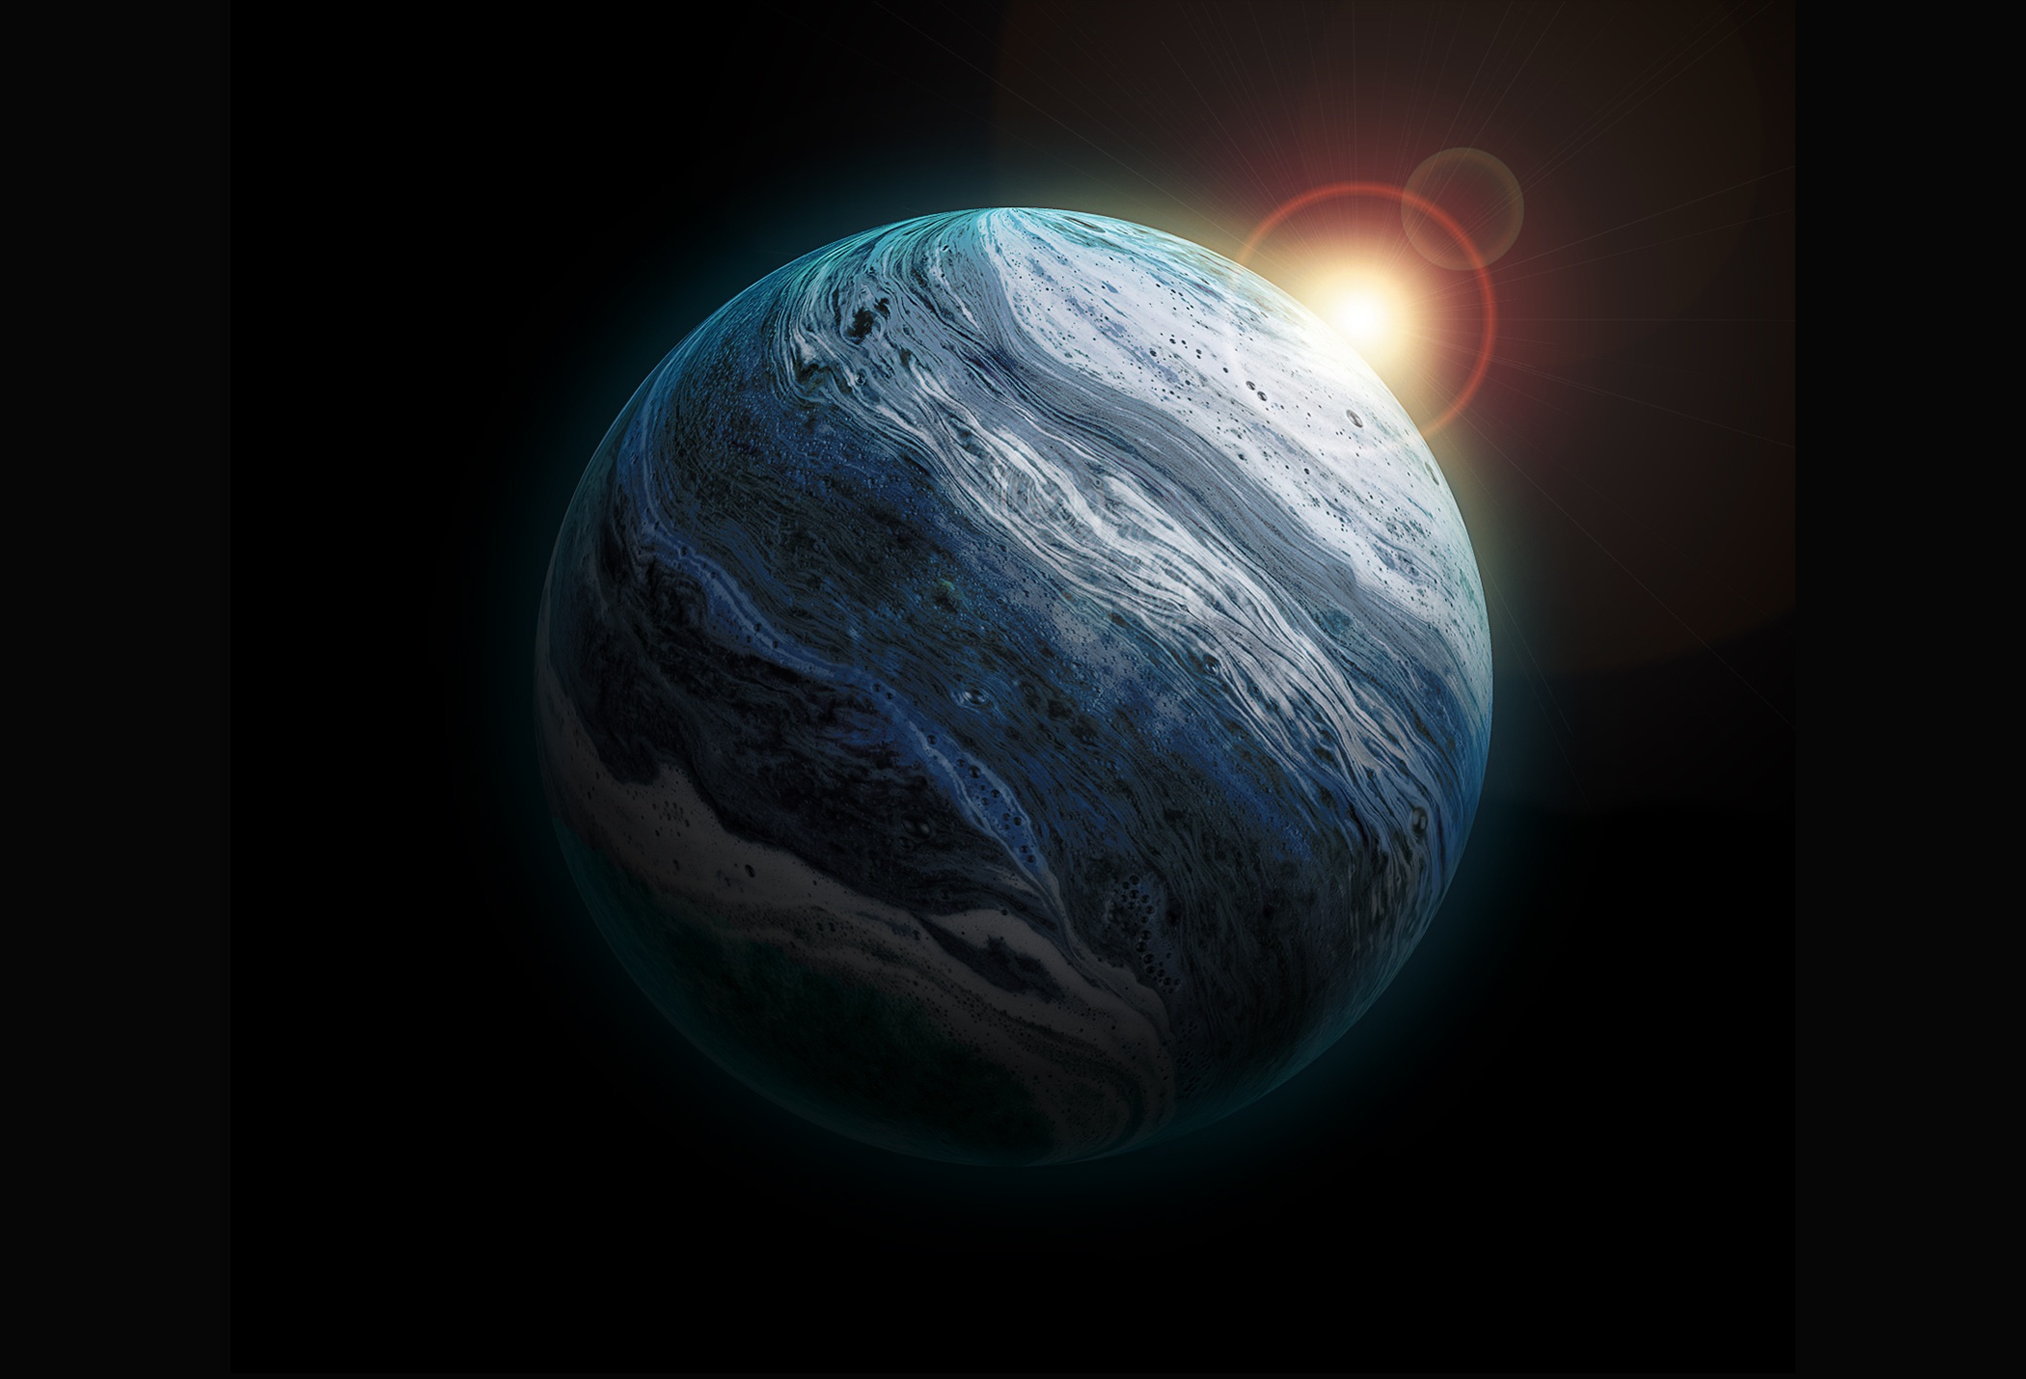

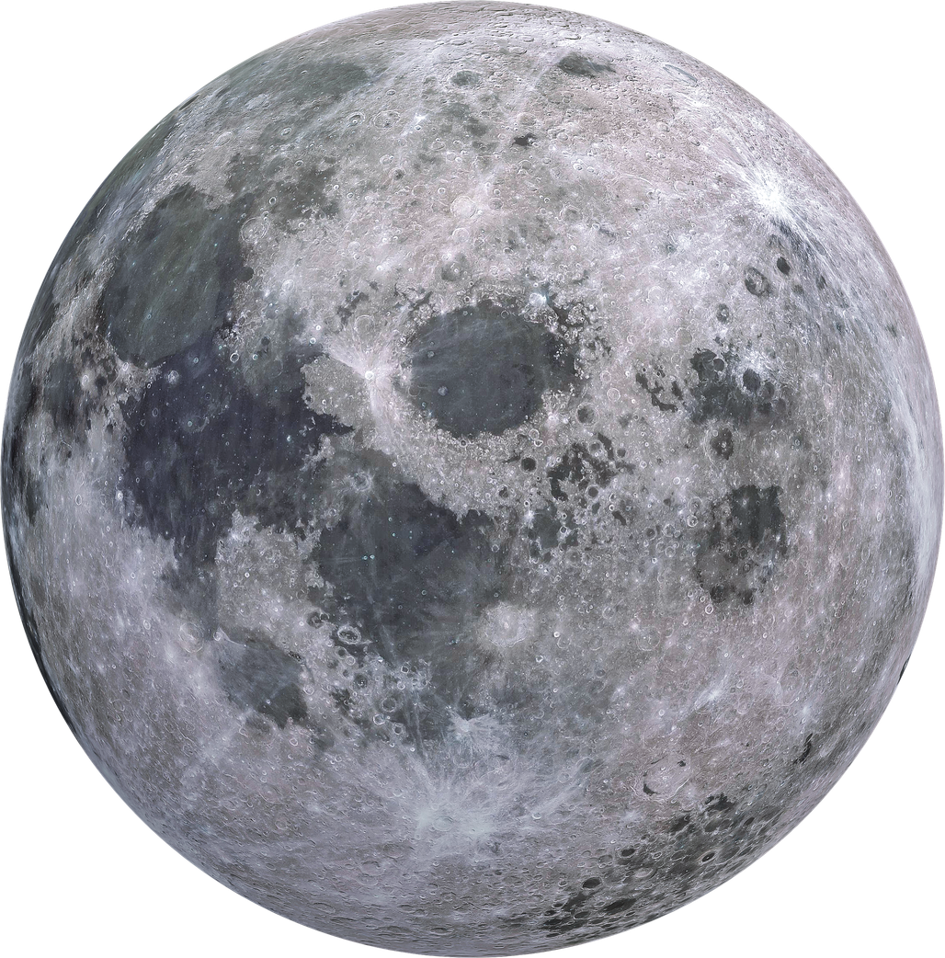
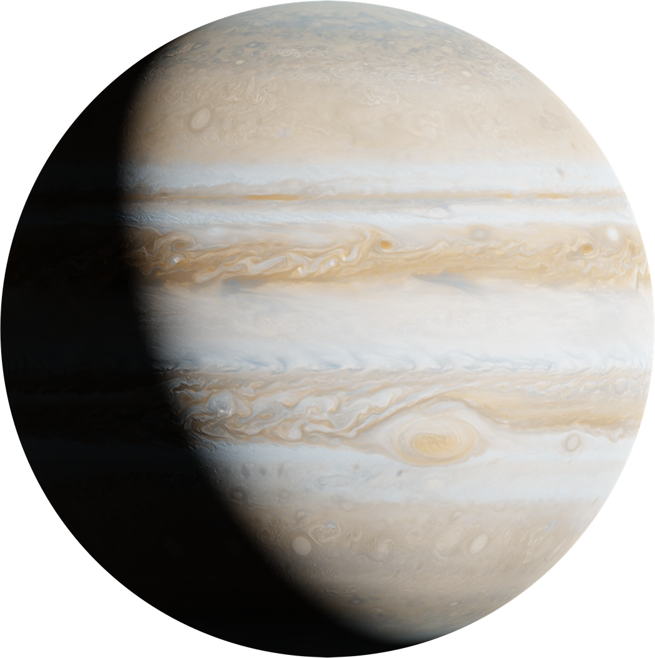
SOLAR SYSTEM
Exploring the wonders of our Solar System and its celestial bodies
DR. MAHMOUD EMAM
DR. MAHMOUD ESSA
PAGE 01
COURSE CODE: CSC-2203

Slide 2
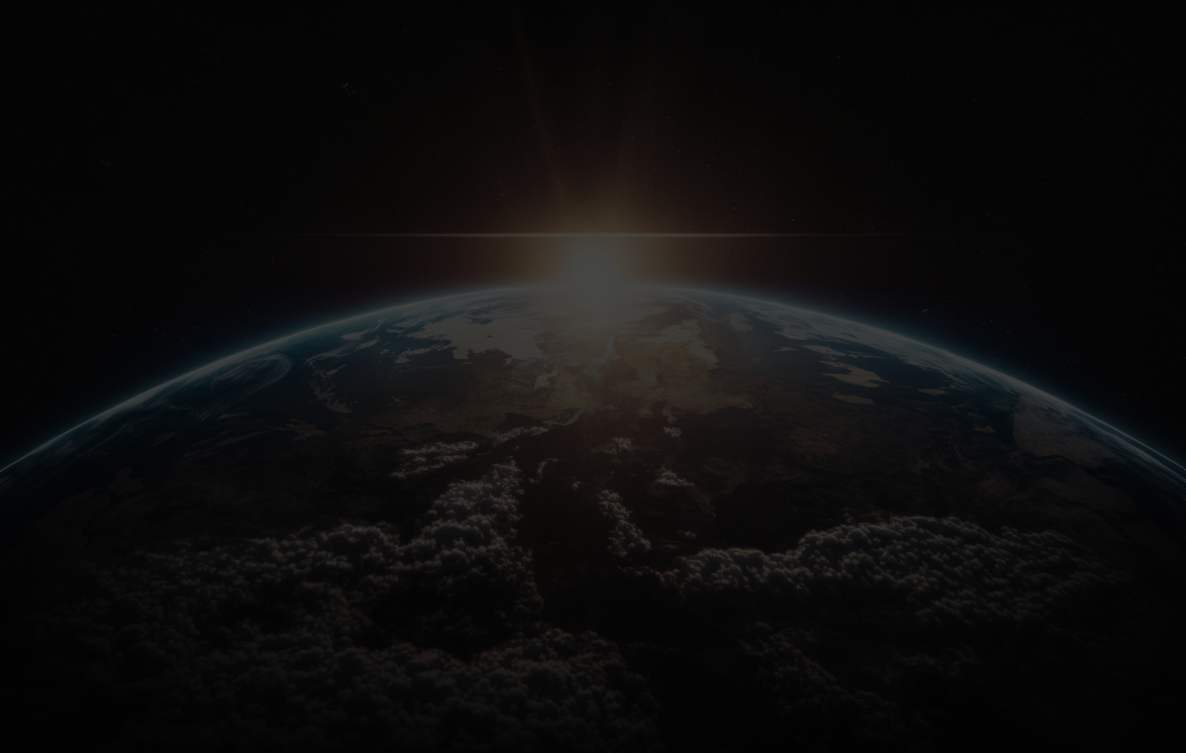
The Idea
  Description: A real-time, 3D mathematical simulation of our Solar System.
  Core Technology: Built entirely from the ground up using C++ and the OpenGL graphics API. We explicitly avoided high-level game engines (like Unity or Unreal) to gain a foundational understanding of the graphics rendering pipeline.
  Purpose: To create an interactive, visually engaging educational tool demonstrating planetary orbits, hierarchical modeling, and core computer graphics concepts.
Project Overview
PAGE 02

Slide 3
Project Overview
Objectives & Goals
  Orbital Mechanics: Demonstrate accurate relative planetary movement, approximating elliptical orbits and variable orbital speeds based on distance from the central star.
  Graphics Mathematics: Implement core graphical transformations (translation, rotation, scaling) using matrix algebra.
  System Interactions: Showcase dynamic system interactions, user input processing, and real-time rendering loops.
  Advanced Techniques: Apply advanced graphics techniques like the Phong lighting model and UV texture mapping.
  Importance of Interactive Elements: Real-time rendering transforms a passive viewer into an active explorer. Being able to change perspectives, alter time speeds, or toggle rendering modes drastically improves knowledge retention. It provides a hands-on learning experience that static textbooks simply cannot offer, allowing the user to "feel" the spatial relationships between bodies.
PAGE 03

Slide 4
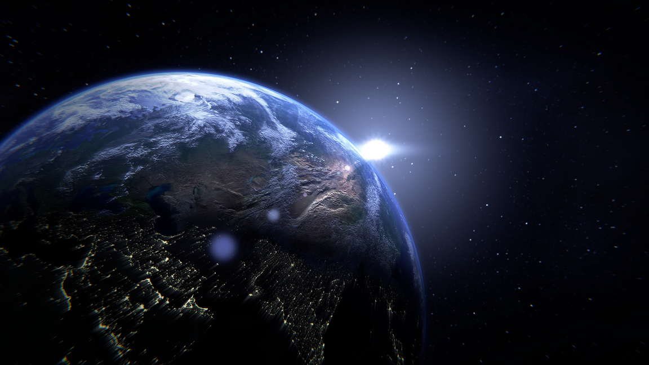
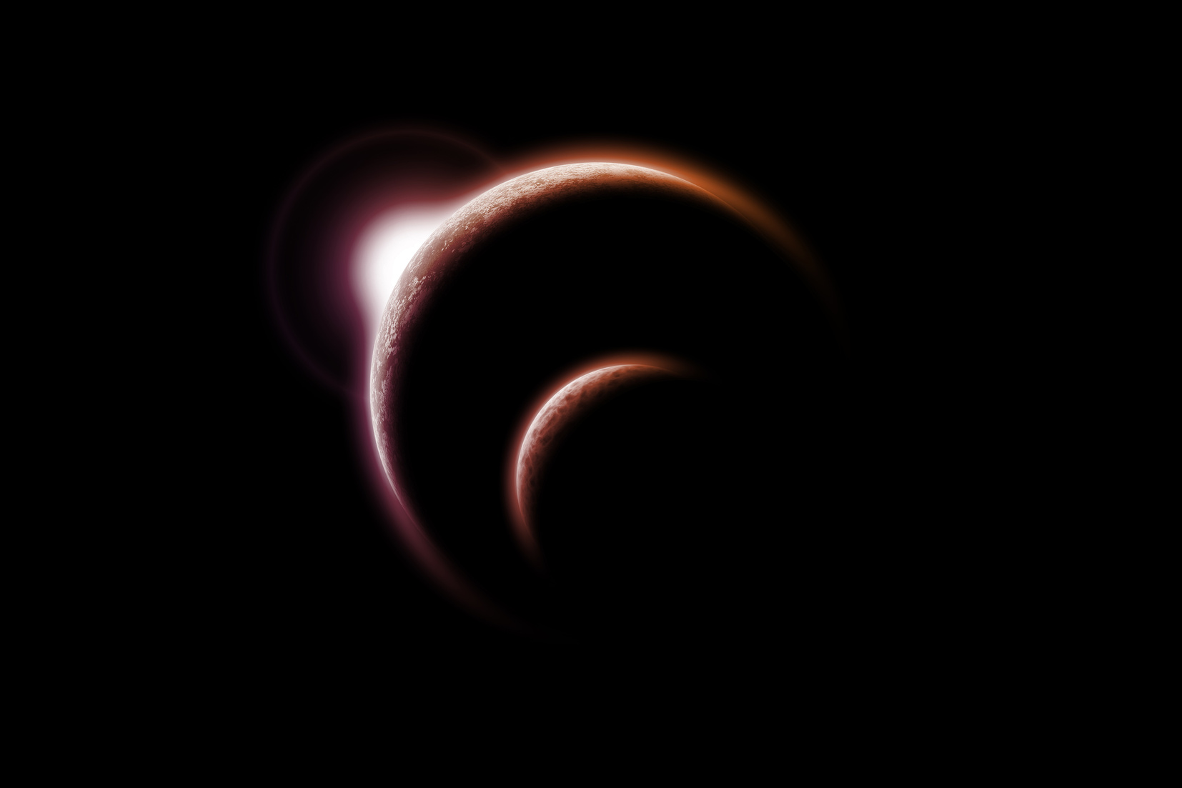
Graphics Concepts
Transformations and Math
  Scaling Matrix: Used to give each planet and the sun relative size differences. This is vital for conveying the immense variation in scale across the solar system, requiring precise float values to scale the unit sphere down to Earth-size or up to Jupiter-size.
  Translation Matrix: Applied to position planets at specific Euclidean distances from the sun, accurately representing orbital radii. This moves the object from the global origin to its specific orbit path.
  Rotation (Self): Simulating the day/night cycle of planets rotating on their local Y-axis, demonstrating angular momentum.
  Rotation (Orbital): Simulating the yearly orbit of planets around the sun.
PAGE 04

Slide 5
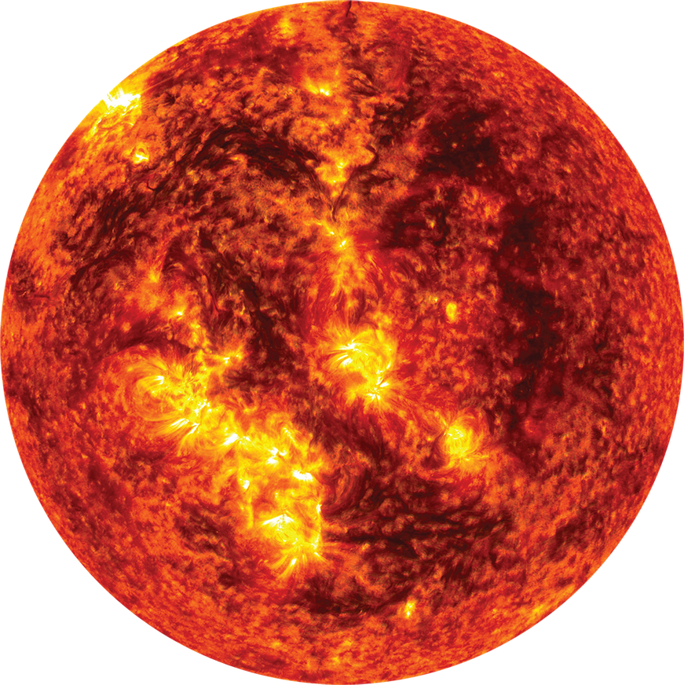
Graphics Concepts
Lighting and Materials
Perception of 3D Shapes: Lighting is the most powerful tool for tricking the brain into perceiving 3D volume on a 2D screen. The interplay of shadows and highlights provides the necessary visual cues to understand a planet's curvature.
The Phong Reflection Model:
  Ambient Light: A low-level base light ensuring the dark sides of planets aren't pitch black, simulating light scattering in space.
  Diffuse Light: Directional light that scatters upon hitting a surface. This creates the primary shading and the "terminator line" (the line between day and night on a planet) based on the surface normal vectors.
  Specular Light: The bright highlight or reflection. We configured material properties so rocky planets (Earth, Mars) have low shininess, while water or gas giants may have different reflective properties.
PAGE 05

Slide 6
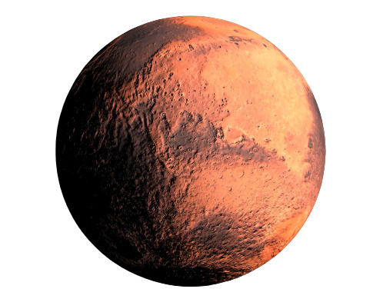
Graphics Concepts
Textures and Mapping
  Enhancing Realism: The process of mapping flat 2D image arrays (bitmaps) onto 3D spherical geometry.
  UV Coordinate Mapping: Generating specific (U, V) coordinates for every vertex on the sphere. This tells OpenGL exactly which pixel (texel) of the 2D image corresponds to which 3D point, wrapping the high-resolution planetary maps seamlessly.
Contribution to Visual Fidelity: Without textures, the simulation is just a collection of differently colored smooth spheres. Applying high-resolution NASA imagery grounds the simulation in reality, allowing viewers to recognize the Great Red Spot on Jupiter or the continents of Earth.
PAGE 06

Slide 7
Graphics Concepts
Camera Navigation & Projection
  Perspective Projection: We used gluPerspective to create a viewing frustum (a 3D pyramid of vision). This gives a true 3D sense of depth, ensuring distant planets appear appropriately smaller than closer ones, mimicking human optical vision and the concept of foreshortening.
  The LookAt Matrix: Utilized gluLookAt to define the camera's position in space, the exact point it is looking at (the target), and the "Up" vector to orient the camera.
  Interactive Viewing: Implemented a user-controlled camera linked to keyboard and mouse callbacks.
  Immersive Exploration: The camera system acts as the user's personal spacecraft. By granting full 6 Degrees of Freedom (6DoF) spatial freedom, it allows for an immersive exploration of the Solar System from any angle—whether hovering above the ecliptic plane or getting up close to see a planet's rotation.
PAGE 07

Slide 8
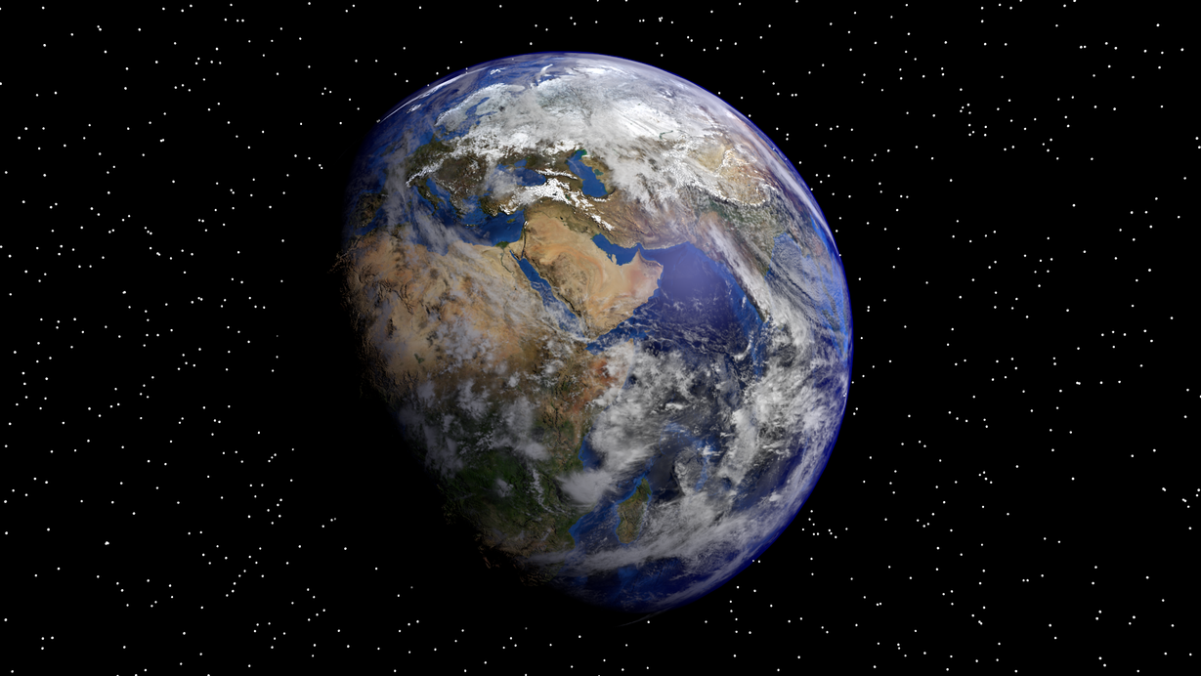
System Demonstration
Live View & Architecture
  Showcasing the Initial State: The Sun at the center with planets positioned in their respective orbits, immediately demonstrating the vast scales involved.
  The Render Loop: Explaining what is happening behind the scenes. Every fraction of a second, the screen is cleared, the depth buffer (Z-buffer) is reset, new positions are calculated based on delta-time, and the entire scene is redrawn.
  Double Buffering: Mentioning how smooth animation is achieved. We draw to a hidden "back buffer", and when the frame is complete, we swap it with the "front buffer" displayed on the monitor. This eliminates screen tearing and flickering, heavily enhancing the user experience.
PAGE 08

Slide 9
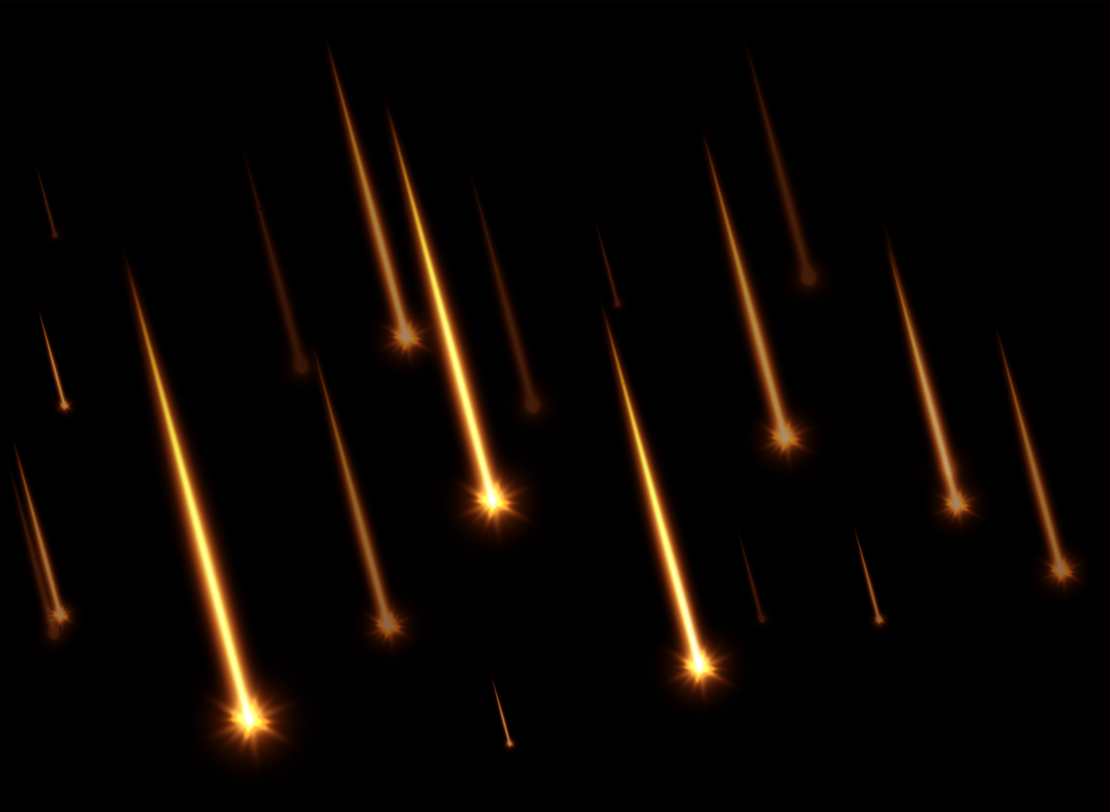
Technical Implementation
Setup and Stack
  Environment: Developed in Visual Studio using C++, utilizing the MSVC compiler and linker to build a native Windows executable.
  Libraries Chosen and Why:
  OpenGL (Core API): The industry-standard, cross-platform hardware acceleration API for rendering 2D and 3D vector graphics.
  GLFW / FreeGLUT: Window creation and OS-level input handling. We used this because creating native Win32 windows from scratch is excessively verbose; this library abstracts the OS layer perfectly.
  GLAD / GLEW: Extension loading libraries. Essential for accessing modern OpenGL functions (like shaders or modern texture bindings) supported by the graphics card drivers.
  SOIL / stb_image: A lightweight C-based library chosen specifically for its hassle-free ability to load .jpg and .png files directly into byte arrays for OpenGL texture generation without adding massive dependencies.
PAGE 06

Slide 10
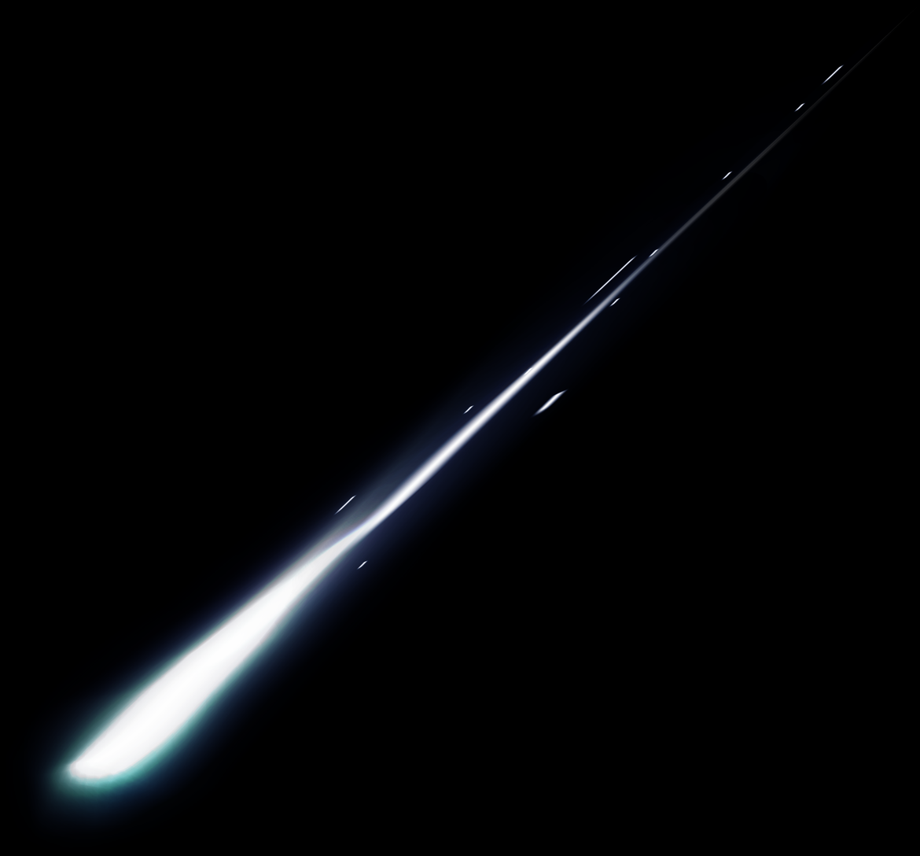
Technical Implementation
Complexity & Optimization
  State Management Machine: OpenGL acts as a massive state machine. We had to carefully manage when to bind textures, when to enable/disable lighting, and when to push/pop matrices. Doing this inefficiently results in visual bugs (e.g., the Sun accidentally receiving Earth's texture).
  Z-Buffering (Depth Testing): Crucial for a 3D scene. We enabled GL_DEPTH_TEST so that OpenGL automatically calculates which pixels are closest to the camera, ensuring that a moon passing behind a planet is correctly obscured, rather than drawn on top of it.
  Ensuring Smooth Performance: Managing multiple objects required careful architecture. By structuring the rendering loop efficiently and keeping our matrix stack shallow, we ensured that calculating the position of dozens of celestial bodies only required minimal matrix multiplications, saving CPU cycles.
PAGE 06

Slide 11
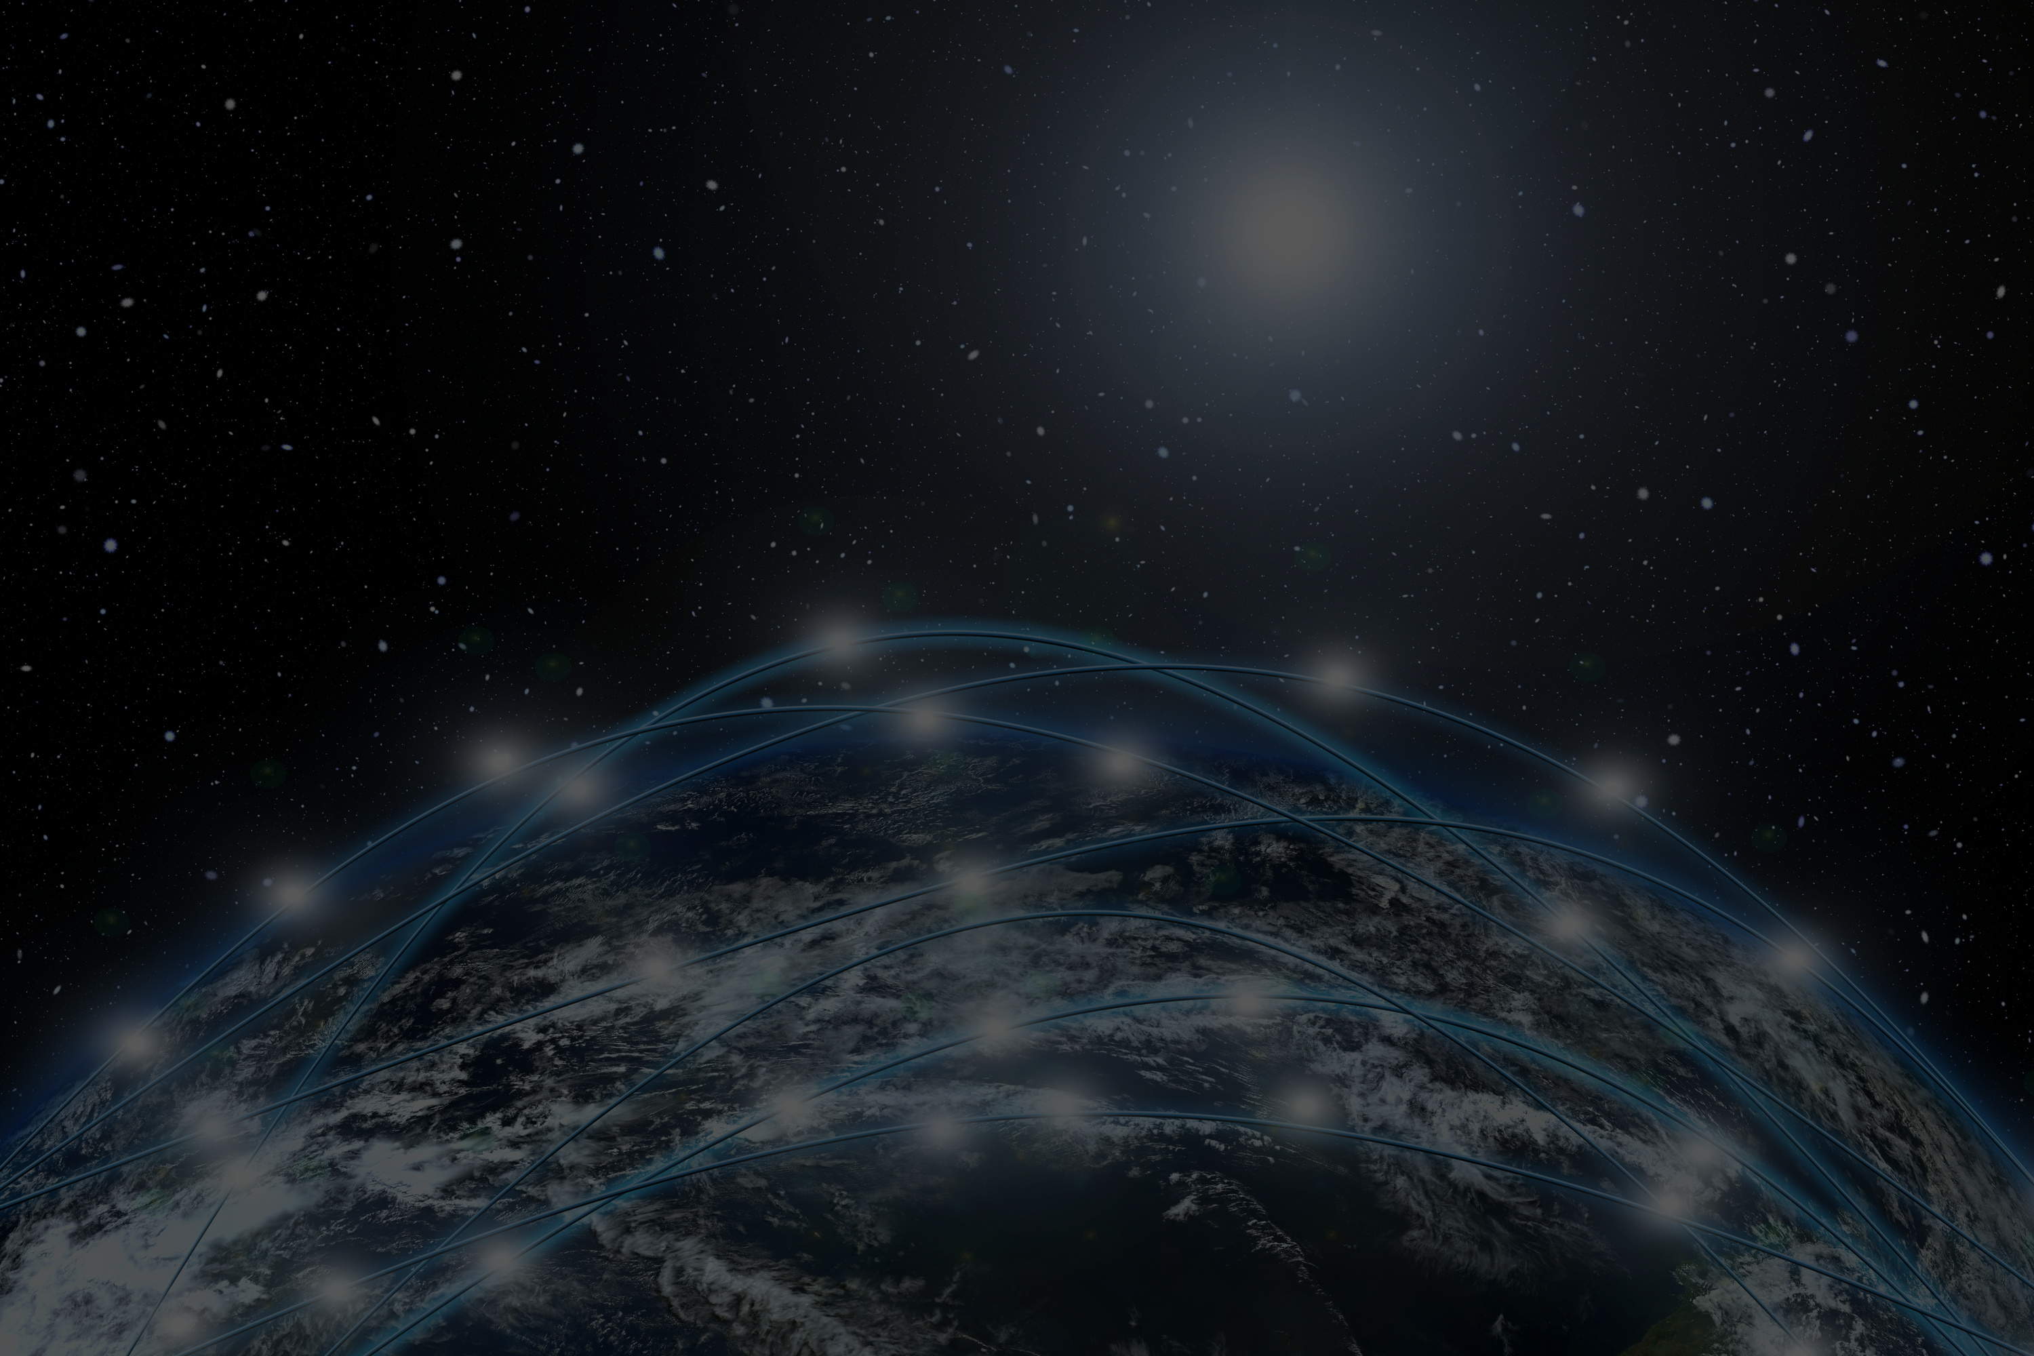
Team Contribution
  Ahmed Mohamed Refaat | 692400154 | C2
The Solar System + Movements
  Ebrahim Yussif Ebrahim | 692400174 | C4
Earth, Asteroids, and controlling the PlayStation arm
  Noura Maher Mohamed | 692400276 | C3
Mars, Meteors, and Camera
  Ferial Mohamed Saed | 692400369 | C4
Venus, Jupiter, and Collision
  Noha Mohamed Hamdi | 692400012 | C3
Neptune and Mercury
  Mohamed Yehia Abdelhamid | 692400354 | C1
Uranus
  Ahmed Yousry Tagelmoulok | 692400354 | C1
Saturn
PAGE 10

Slide 12
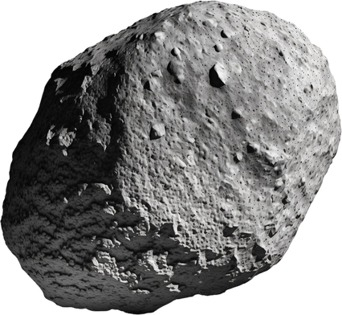
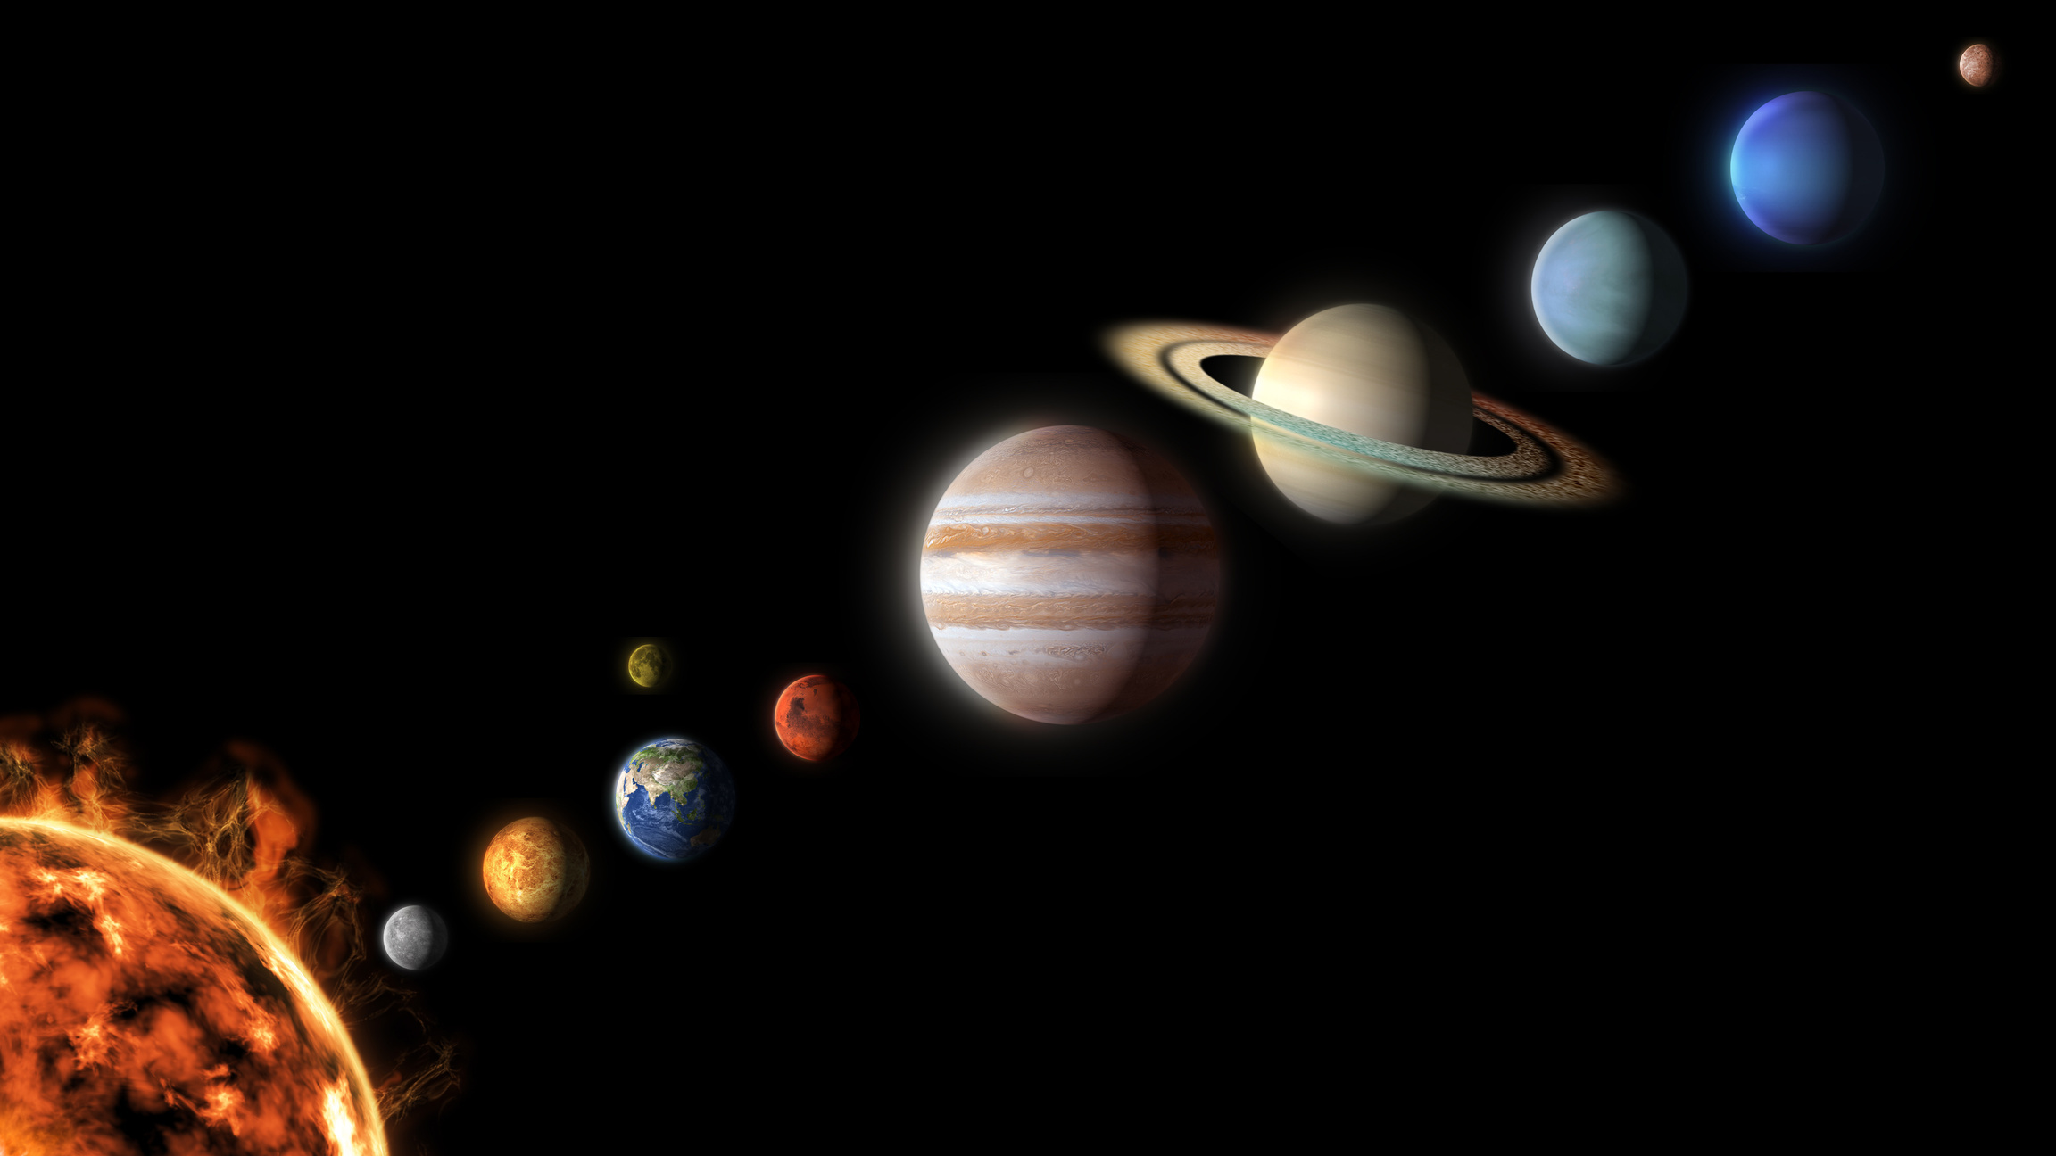
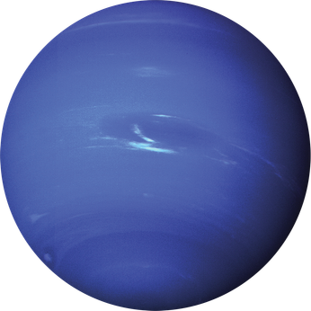
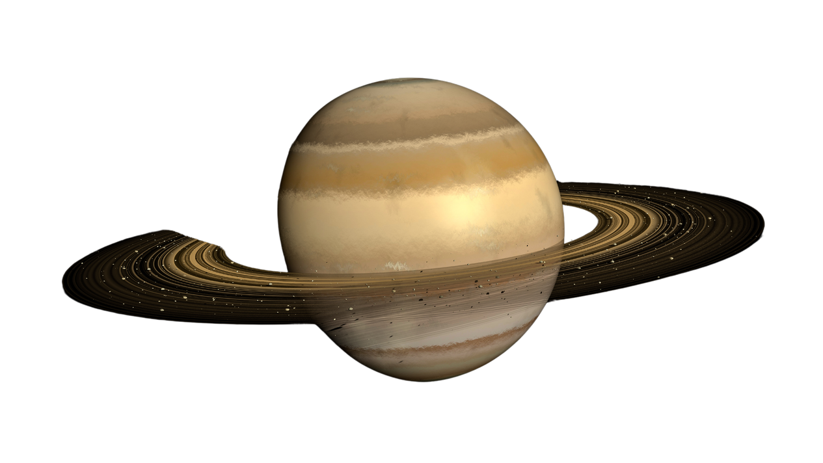
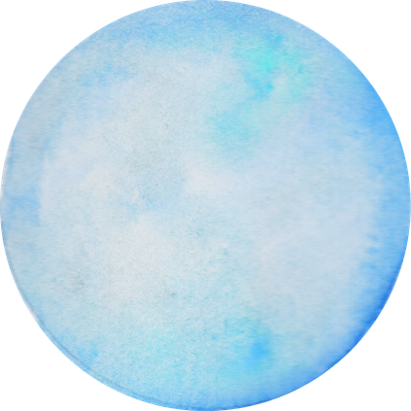
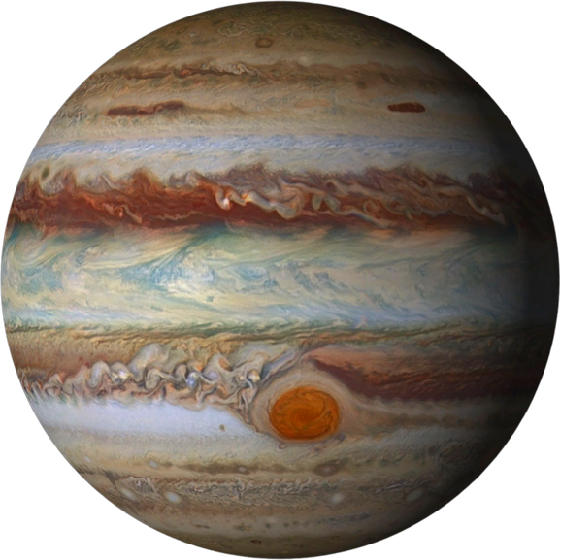
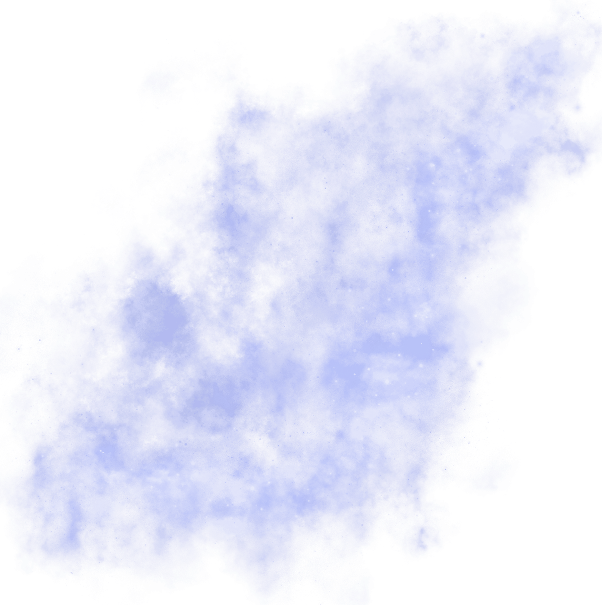
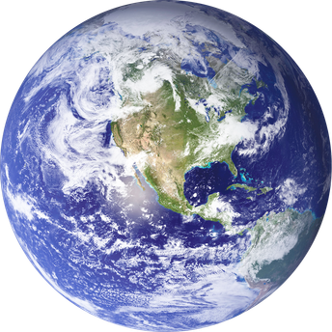
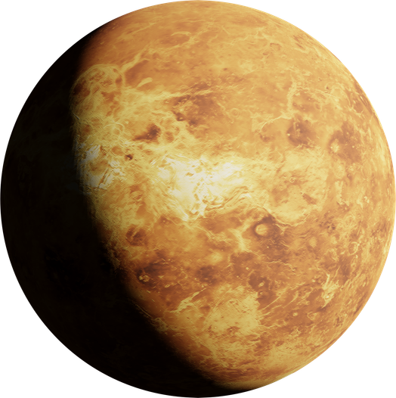
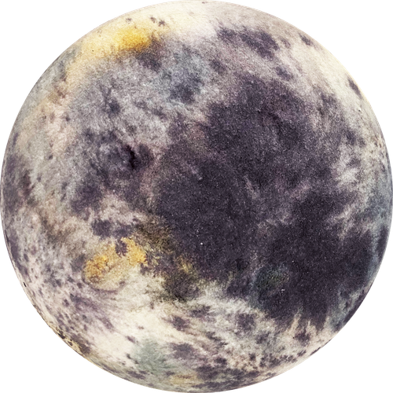
Tilts sideways, pale blue color.
THANK
Uranus
Giant storm, many moons.
YOU
Jupiter
Neptune
Farthest planet, fastest winds.
Only planet known to support life.
Earth
Smallest planet, no atmosphere.
Sartun
Mercury
Beautiful rings, gas giant, low density.
Mars
Red planet, tallest volcano.
Venus
We would like to sincerely thank Dr. Soha Safwat, Dr. Mahmoud Emam, Dr. Mahmoud Essa, Eng.Mohamed Hemdan and Eng.Ramez Yousri
For their valuable support and great efforts throughout our project.
Your guidance and encouragement meant a lot to us and truly made a significant difference.
Hottest planet, thick atmosphere.

